Slide 1

Project 4 Proposal KwonPlayer
March 18th, 2016

Slide 2

Table of Contents
Project Objective
Research Methodology & Analysis
Target Demographic
User Stories
Competitive Analysis
Wireframes & Key Features
Constraints

Slide 3
Project 4 Objective
Create an Android Mobile App that streamlines a user’s access
to all their favorite media content into a single user interface

Slide 4
Research & Analysis
Methodology:
Conduct quantitative research with target demographic via survey, to identify common pain-points and key mobile behaviors
Key Findings:
Top media streaming apps: Spotify, Google Play Music, SoundCloud, Tidal, Pandora, YouTube, Netflix
Streaming applications are preferred in social situations where wi-fi is available (to prevent draining data plans), while files on device are used more for personal listening and when mobile data is unavailable
Users rarely switch between media applications during a single listening session
Application preferences driven by: Song availability, Prominence of pay walls and/or ads, search capabilities
Conclusion:
Consolidating various media applications into a single portal can increase user utility, while also giving app developers a larger share of customer attention by reducing barriers to trying different services

Slide 5

Target Demographic
Name: Laura Smith
Bio: 27 year old, single female sharing a 3 bedroom apartment in the Upper East Side with 2 friends from college; works in publishing; holds a B.A. in English from Michigan
Interests: Indie music, grabbing coffee in her neighborhood, Sunday boozy brunch, watching 80’s rom-coms with roommates and a bottle of wine
Goals: Score above 700 on the GMAT and apply to business schools in New York to switch into a brand management role

Slide 6
User Stories
As a User, I can listen to all my favorite songs in a single playlist regardless of platform availability/exclusivity
As a User, I can search for content across multiple media properties without switching applications
As a User, I can choose between multiple media player interfaces on my mobile device (vs. being stuck with the manufacturer’s default option)

Slide 7
Competitive Analysis

Slide 8
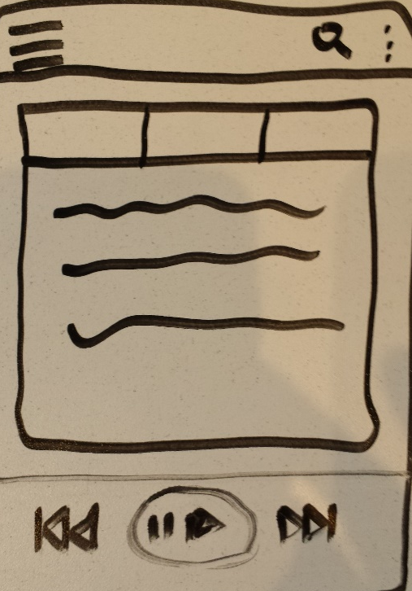
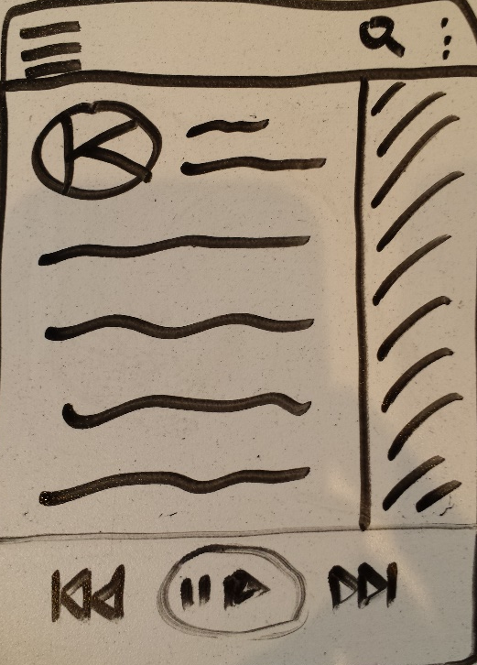
Wireframes & Features
Hamburger menu launches drawer to access 3rd Party Streaming options
Search launches targeted song directly
Home Screen allows scrolling between songs via Tab Layout Fragments
Background customizable via skins
Persistent playback controls anchored to bottom of all activities

Slide 9
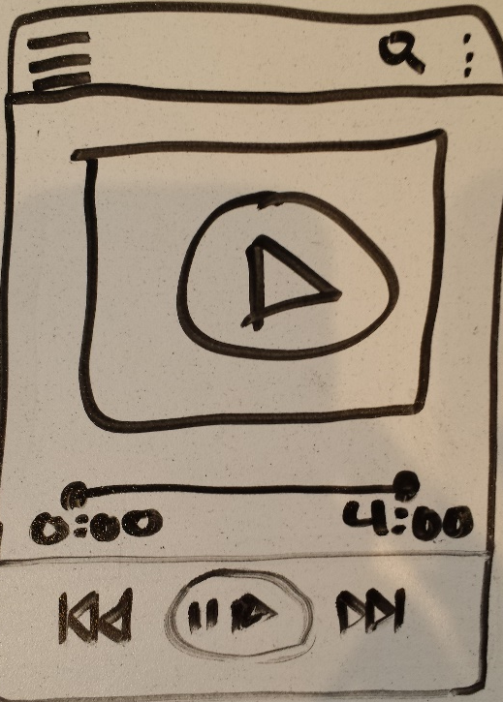
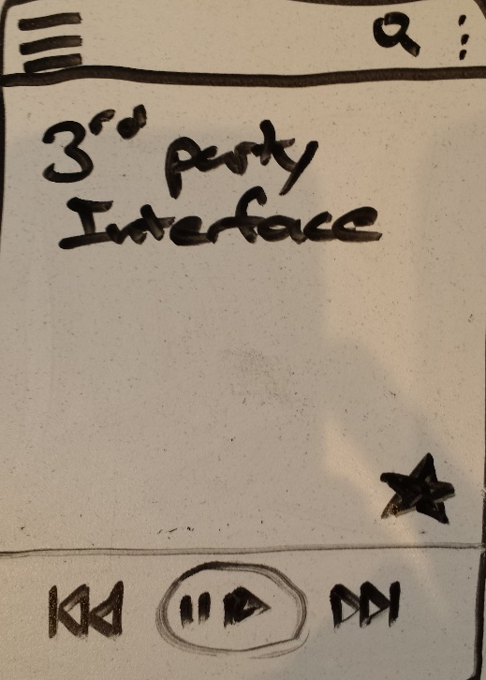
Wireframes & Features
Persistent hamburger menu allows fluid navigation to all parts of app from anywhere
Default Media Playback interface provides greater detail on content
Depending on API flexibility, 3rd party interface will be custom to available playback options
Key feature will be to save a song from any API and add it to a universal API
Persistent media control panel at bottom of activity

Slide 10
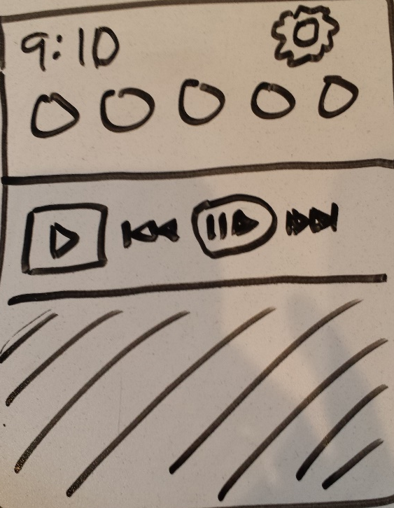
Wireframes & Features
Persistent Notification that controls media playback
Panel can launch app directly from Notification panel
Playback controls display on phone’s lock screen as well

Slide 11
Constraints
Resources: Implementing all features within a 2-week timeframe will be difficult to achieve on my own
Risk Mitigation: Prioritizing key features can ensure I release a minimal viable product by the 4/5 launch date, with subsequent version updates addressing all remaining features
Technology: This is my first time working with any of the 3rd Party media API’s
Risk Mitigation: Researching these first and focus on having one or two done by launch

